Slide 1
Files & File system

Slide 2
A Possible File System Layout
Superblock contains info about the fs (e.g. type of fs, number of blocks, …)
i-nodes contain info about files
Tanenbaum, Modern Operating Systems 3 e, (c) 2008 Prentice-Hall, Inc. All rights reserved. 0-13-6006639

Slide 3
File System
A file system is consists of a sequence of logical blocks (512/1024 byte etc.)
A file system has the following structure:
Boot Block | Super Block | Inode List | Data Blocks

Slide 4
File System: Boot Block
The beginning of the file system
Contains bootstrap code to load the operating system
Initialize the operating system
Typically occupies the first sector of the disk

Slide 5
File System: Super Block
Describes the state of a file system
Describes the size of the file system
How many files it can store
Where to find free space on the file system
Other information

Slide 6
File System: Inode List
Inodes are used to access disk files.
Inodes maps the disk files
For each file there is an inode entry in the inode list block
Inode list also keeps track of directory structure

Slide 7
File System: Data Block
Starts at the end of the inode list
Contains disk files
An allocated data block can belong to one and only one file in the file system

Slide 8
kernel Architecture (UNIX)
User program
Library
User level
system call interface
kernel level
File Subsystem
Inter process
communication
Buffer Cache
Process Control
Subsystem
Scheduler
Memory Management
character block
Device driver
Hardware control
kernel level
hardware
User level

Slide 9
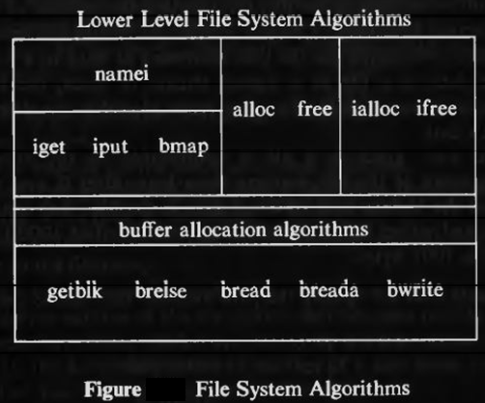
Low level file system algorithms in unix

Slide 10
File system algorithms
algorithm ialloc : assigns a disk inode to a newly created file
Algorithm alloc: allocates a data block from a file system to a newly created file
Algorithm namei : converts the file names manipulated by process to inodes used internally by the kernel
iget, iput : conrols the allocation of in-core inodes when the process access a file.
bmp : locates the disk blocks of a file,

Slide 11
Inode
contains the information necessary for a process to access a file
exits in a static form on disk and the kernel
reads them into an in-core inode
Contains the administrative information of a file

Slide 12
Inodes
consists of
- file owner identifier
- file type
- file access permissions
- file access times
- number of links to the file
- table of contents for the disk address of data in a file
- file size

Slide 13
In-core inodes
in-core copy of the inode contains
- status of the in-core inode
- logical device number of file system
- inode number
- pointers to other in-core inodes
- reference count

Slide 14
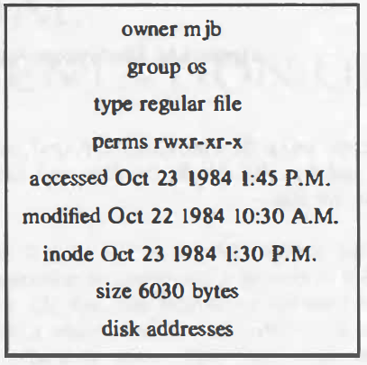
Sample disk i-node

Slide 15
Directories
Directories are files that give the file systems its hierarchical structure
They play an important role in conversion of a file name to an inode number
A directory is a file whose data is a sequence of entries, each consisting of an inode number and the name of a file contained in the directory
Each component except the last must be the name of a directory, last component may be a non-directory file

Slide 16
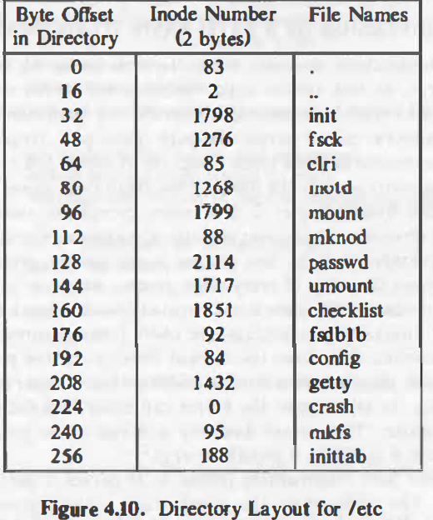
Directory layout for /etc

Slide 17
Algorithm namei
- If path name starts from root, then the kernel assigns root inode(iget) to working inode
- Otherwise, the kernel assigns current directory inode to working inode
- While there is more path name, the kernel reads next path name component from input, and verifies that working inode is of directory, access permissions OK
• If working inode is of root and component is ‘..’, then the kernel checks whether there is more path name or not
• Otherwise the kernel reads directory by repeated use of bmap,bread,brelse

Slide 18
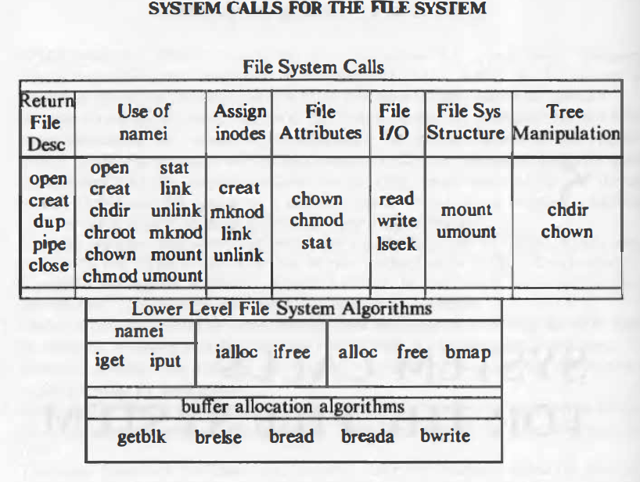
Super block
consists of
- the size of the file system
- the number of free blocks in the file system
- a list of free blocks available on the file system
- the index of the next free block in the free block list
- the size of the inode list
- the number of free inodes in the file system
- a list of free inodes in the file system
- the index of the next free inode in the free inode list
- lock fields for the free block and free inode lists
- a flag indicating that the super block has been modified

Slide 19

Open
Fd=open(pathname, flags, modes);
Pathname : file name
Flags : type of the open
Modes : file permission (esp for creat)
Returns an integer called the user file decriptor

Slide 20
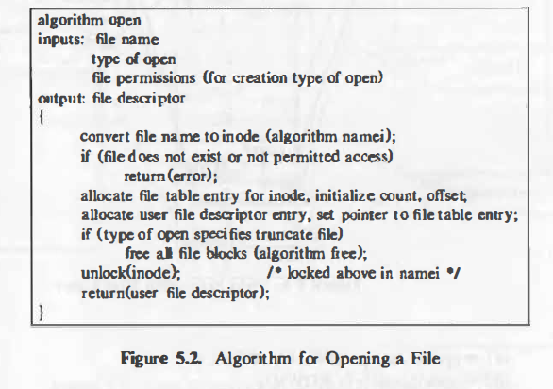
Algorithm for open

Slide 21
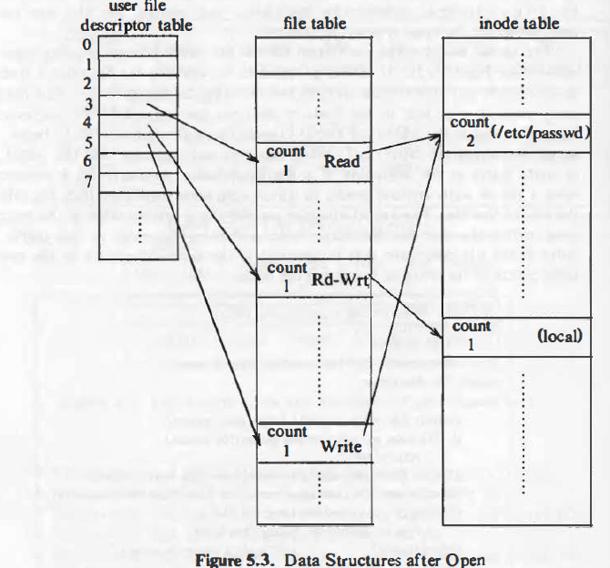
Data structures for open

Slide 22
Read
The syntax of the read system call is
number = read(fd, buffer, count)
-fd is the file descriptor returned by open
-buffer is the address of the data structure
-Count is the number of bytes the user wants to read
-number is the number of bytes actually read

Slide 23
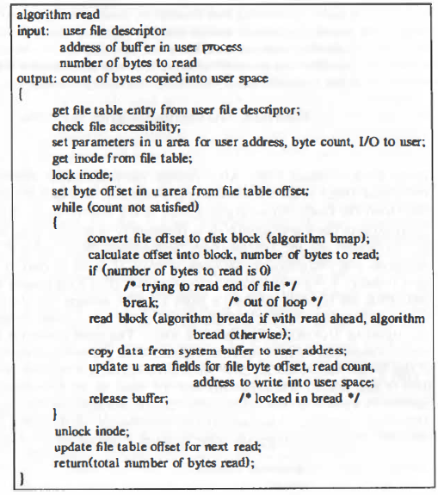

Slide 24
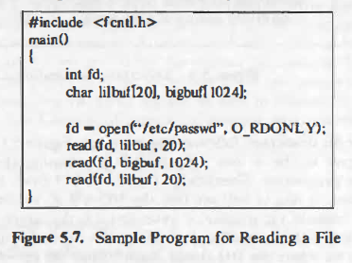

Slide 25
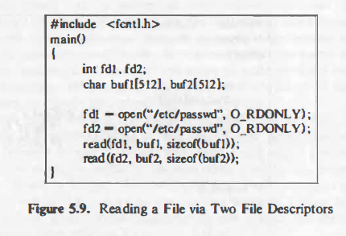

Slide 26
Write() system call
The syntax for the write system call is
number = write(fd, buffer, count);
where the meaning of the variables fd, buffer, count, and number are the same as they are for the read system call.
The algorithm for writing a regular file is imilar
to that for reading a regular file.

Slide 27
Creat()
the creat system call creates a new file in the system. The syntax for the creat system call is
fd - creat(pathname, modes) ;
where the variables pathname, modes, and fd mean the same as they do in theopen system call.

Slide 28
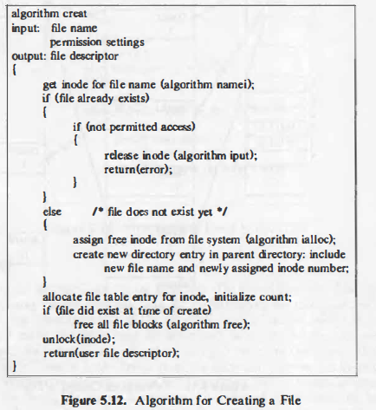

Slide 29
Close()
The syntax for the close system call is
close(fd);
where fd is the file descriptor for the open file.
The kernel does the close operation by manipulating the file descriptor and the corresponding file table and inode table entries. If the reference count of the file table entry is greater than 1

Slide 30
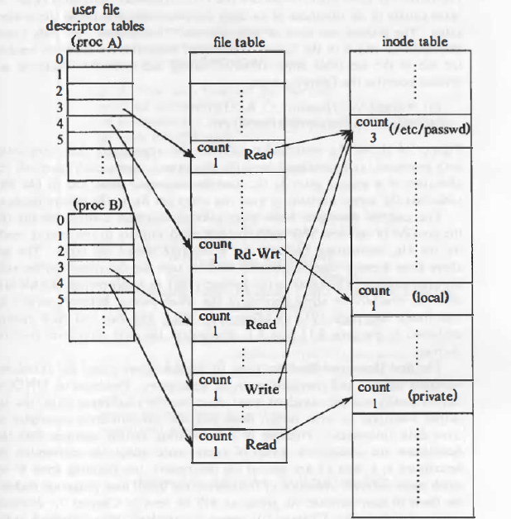
fd1= open(''/etc/passwd", O_RDONLY); fd2 ,.,. open("private", O_RDONLY);

Slide 31
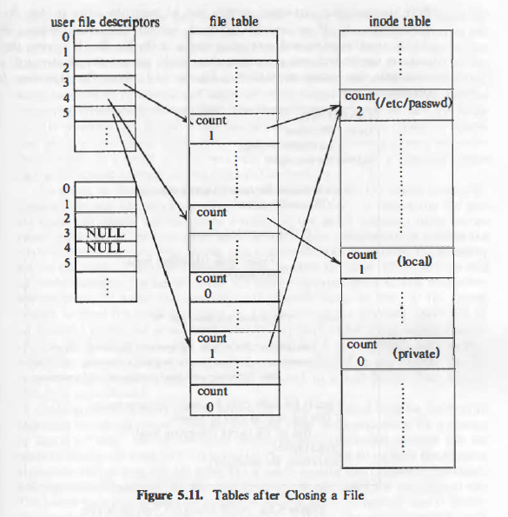
Tables after closing a file

Slide 32
STAT AND FSTAT
The system calls stat and fstat allow processes to query the status of files, returning information such as the file type, file owner, access permissions, file size, number of links, inode number, and file access times. The syntax for the system calls is
stat(pathname, statbuffer);
fstat(fd, statbuffer) ;
where pathname i s a file name, fd is a file descriptor returned by a previous open call
statbuffer is the address of a data structure in the user process that will contain the status information of the file on completion of the call.
The system
calls simply write the fields of the inode into statbuffer

Slide 33
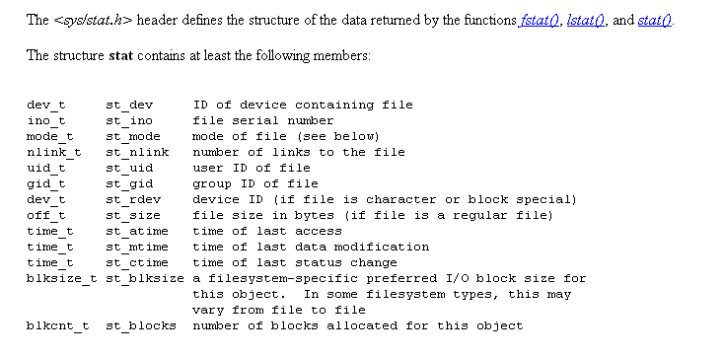
Structure stat

Slide 34
Example pgm
char *name;
int fd;
Struct stat stbuf;
stat(name, &stbuf);
fstat(fd, &stbuf)

